Slide 1
GENU VARUM
BY KOECHISO@GMAIL.COM

Slide 2
INTRODUCTION
The three common deformities are genu varum (bow leg) genu valgum (knock knee) and genu recurvatum (hyperextended knee).
Genu varum is also called bow leg or tibia vara is a physical deformity marked by (outward) bowing of the leg in relative to the thigh, giving the appearance of an archer’s bow.

Slide 3
Normal development of lower extremities:
The uterin space during gestation forces the lower extremity to lie in a “Buddha” position with flexion of the hips and knees and internal rotation of the tibia and feet.

Slide 4
This position causes contracture of the medial knee capsule, especially of the posterior oblique ligament .
Depending on the residual tightness of this capsular/ligamentous contracture at the onset of walking, varying amounts of bowleggedness will still be clinically appreciated.

Slide 5
Over the course of time, these contractures stretch, and spontaneous resolution of this “physiologic” bowing is seen.

Slide 6
NATURAL HISTORY
Genu varum and medial tibial torsion are:
Normal in newborn and infants.
Maximal varus is present at 6 to 12 ms of age.
With normal growth, the lower limbs gradually straighten with a zero Tibio femoral angle by 18 to 24 months of age. (when the infant begins to stand and walk).
Asian Journal of Sports Medicine, Vol 1 (No 1), March 2010, Pages: 46-53

Slide 7

Knees gradually drift into valgus (knock knee).
Valgus deformity is maximal at around age 3-4 years (12 degrees).
Finally the genu valgum spontaneously correct by the age of 7 years (8 degrees in the female and 7 degrees in the male).

Slide 8
The greater degree of valgus in females may be due to their wider pelvis.

Slide 9
Differential diagnosis of genu varum:
Physiologic
Pathologic
A. Blount’s disease
B. Hypophosphatemic or nutritional rickets
C. Posttraumatic
D. Postinfectious
E. Congenital deformities
F. Focal fibrocartilaginous dysplasia
G. Metaphyseal chondrodysplasia
H. Fibrous dysplasia
I. Osteogenesis imperfecta
J. Renal osteodystrophy

Slide 10
Persistent genu varum in the older child
Bowlegs after 2 years of age are considered abnormal.
May be due to persistence of severe physiologic bowlegs (the most common etiology), a pathologic condition, or a growth disorder.

Slide 11
Regardless of the type, the bowing becomes most pronounced during the 2nd year of life, when the child starts ambulating.

Slide 12
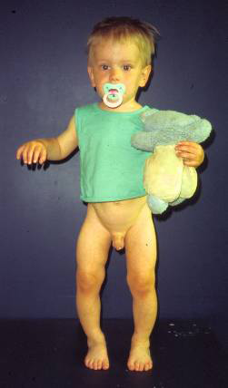
When genu varum occurs concurrent with rotational abnormalities such as internal tibial torsion, the gross clinical appearance of the bowlegs is greatly exaggerated.

Slide 13
Pathologic genu varum:
Focal and systemic conditions may lead to the deformity.
This can affect a specific region in the knee, or the bone , with multiple sites of deformities.

Slide 14
Pathologic deformities tend to occur more unilaterally.
Clinically they also present with a lateral thrust due to varus instability at the knee.

Slide 15
Pathological
Genu varum may also occur in adults.
In both children and adults it may occur as a consequence of injury or disease.
Disorders which cause distorted epiphyseal and/or physeal growth may give rise to bow leg or knock knee;
these include some of the skeletal dysplasias and the various types of rickets, as well as injuries of the epiphyseal and physeal growth cartilage.
A unilateral deformity is likely to be pathological.

Slide 16
Blount’s Disease
can occur in toddlers as well as in adolescents.
results from an abnormality of the growth plate in the upper part of the tibia.
Growth plates determine the length and shape of the adult bone. In a child under the age of 2 years, it may be impossible to distinguish infantile Blount’s disease from physiologic genu varum.
By the age of 3 years, however, the bowing will worsen and an obvious problem can often be seen in an X-ray.
Progressive; associated abnormal growth of the posteromedial part of the proximal tibia.
The condition is bilateral in 80% of cases and black children are affected more. The condition is noticeably worse than in physiological bow legs and may include internal rotation of the tibia.
Spontaneous resolution is rare.

Slide 17
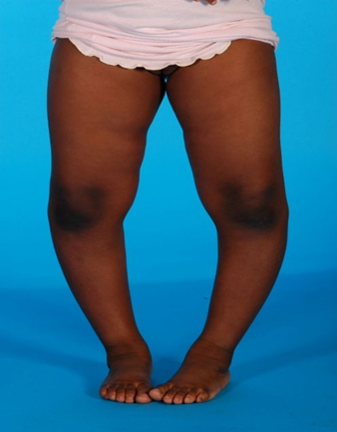
A child with Blount’s disease…

Slide 18
Rickets
bone disease in children that causes bowed legs and other bone deformities.
Children with rickets do not get enough calcium, phosphorus or vitamin D.
Nutritional rickets unusual in developed countries.
can also be caused by a genetic abnormality that does not allow vitamin D to be absorbed correctly. This form of rickets may be inherited.

Slide 19
In adults…
common in adults.
may be sequel to childhood deformity and if so usually cause no problems.
However, if the deformity is associated with joint instability, this can lead to osteoarthritis of the medial compartment.
Other causes include:
Fracture of the lower part of the femur or the upper part of the tibia with malunion.
Osteoarthritis
Rarefying diseases of the bone such as rickets or osteomalacia.
Other bone-softening diseases such as Paget’s disease (osteitis deformans)

Slide 20
Thus, a complete and thorough examination is crucial in the work-up of an older patient presenting with lower extremity bowing.

Slide 21
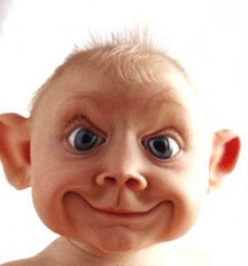
ASSESSMENT
History :

Slide 22
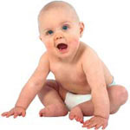
The stature and nutritional status of the child ,
Developmental milestones,
Other nutritional or medical problems.
History of trauma or infections
Exogenous metal intoxication , (lead and
fluoride).

Slide 23

Physiologic genu varum improves with growth, whereas pathologic bowing of the legs increases with skeletal growth.
Limb deformities and presence of short stature may indicate the possibility of bone dysplasia or a generalized growth disorder.
Children with tibia vara (Blount’s disease) are early walkers.

Slide 24
It seems important to ask the parents about:
When they first noticed the deformity .
Were the legs bowed at birth and in infancy, or did the bowlegs develop later on when the child started walking?
Is the deformity improving, staying the same, or increasing in severity?
4. When did the child begin to stand and walk?

Slide 25
ASSESSMENT
Examination :

Slide 26
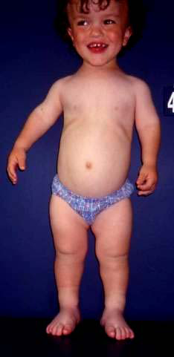
Short stature :
Suggests the possibility of vitamin D refractory (hypo-phosphatemic) rickets or bone dysplasia,
( achondroplasia or metaphyseal dysplasia) .

Slide 27
The level and amount of bowing:
First assessed from the back of the standing child, then with the child supine.

Slide 28
The knee ligament:
For instability, which on ambulation manifests as a lateral thrust.

Slide 29
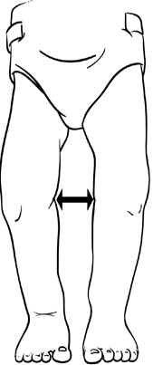

The intercondylar distance:
Performed with the medial malleoli in contact,
Done in stance and supine.
Greater than 6 cm is abnormal.
Ruling out the deformity of the feet
e.g. metatarsus varus or valgus which may represent torsional deformity of the limb .

Slide 30
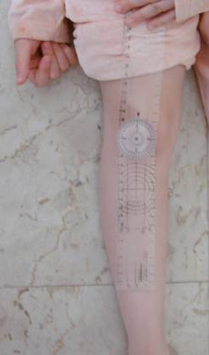
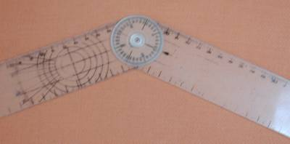
The gross tibio-femoral angle:
Measured using a goniometer.

Slide 31
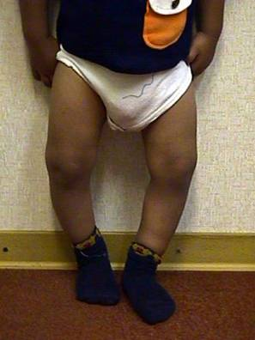
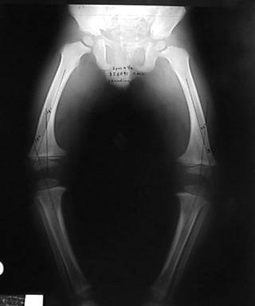
The site of varus angulation:
In physiologic G. V. there is a gentle curve involving both the thigh and the leg .

Slide 32
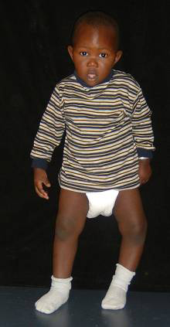
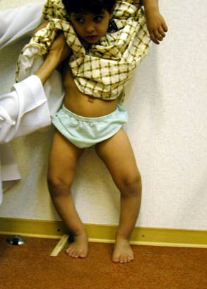
In Blount’s disease it is commonly at the proximal tibial metaphysis with an acute medial angulation immediately below the knee .

Slide 33
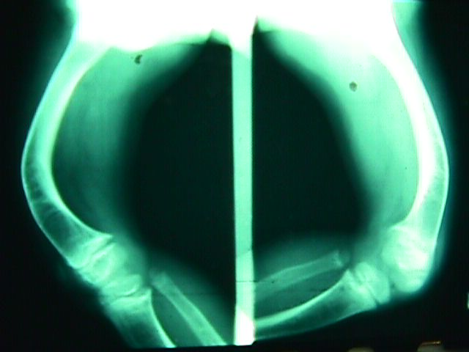
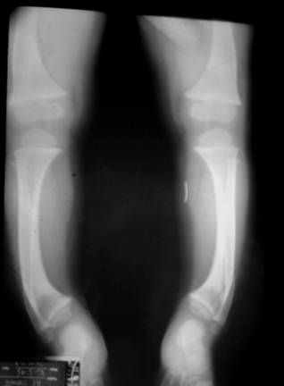
In the very rare distal femoral vara the site of angulation is in the distal femoral metaphysis.
When the lower tibiae are the sites of varus angulation, the upper tibial segment is straight and the lower segment angulated.

Slide 34
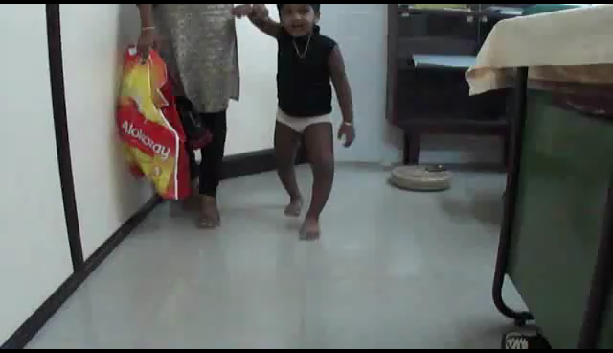
The gait and determine the foot progression angle :
The foot progression angle may be medial or normal.

Slide 35
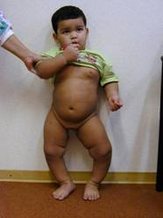
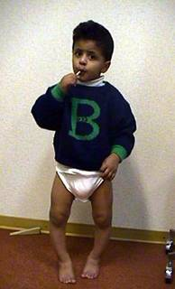
Symmetry of involvement:
In physiologic genu varum it is usually bilateral and symmetric,
Blount’s disease it may be unilateral or bilateral , and asymmetric.

Slide 36
Measure limb lengths :
In Blount’s disease and in congenital longitudinal deficiency of the tibia , the involved limb is shorter than the other one .
In physiologic genu varum the lower limb lengths are even.

Slide 37
Palpate the epiphysis of the long bones. (ankles, knees, and wrists)
In rickets (vitamin D refractory or vitamin deficiency) they are enlarged.

Slide 38
Torsion of the tibia should also be routinely assessed
Determination of the thigh-foot angle and evaluation of the bimalleolar axis

Slide 39
ASSESSMENT
Imaging:

Slide 40
Take radiograms when :
A 3 years and older and the varus deformity is not improving or is getting worse,
The medial bowing is unilateral or asymmetric,
The angulation is acute in the proximal tibial metaphysis immediately below the knee,
The possibility of a pathologic condition.

Slide 41
Full-length standing bilateral antero posterior radiographs from hip to ankle should be obtained.
The focus of the radiograph should be at the knee with both kneecaps pointing forward.

Slide 42
The growth plates of the distal femur and
proximal tibia should be considered carefully.
The horizontal joint lines of both the knee and ankle are tilted medially.

Slide 43
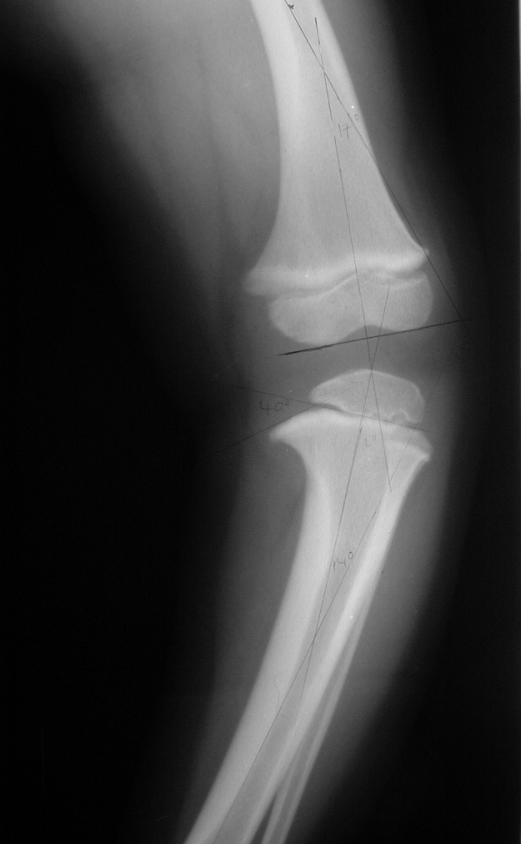
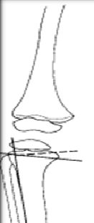
Measure the metaphyseal - diaphyseal angle.
In the physiologic genu varum it is less than 11degrees, whereas in tibia vara it is greater than 11 degrees .

Slide 44
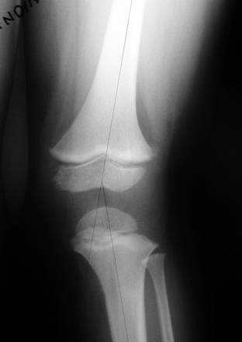
Medial Physeal Slope
Femoral-Tibial Axis

Slide 45

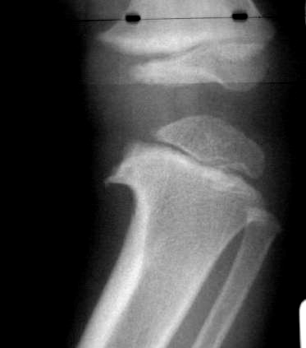
Blount’s disease can be differentiated from physiologic bowing by metaphyseal beaking at the knee, leading to an abrupt varus.

Slide 46
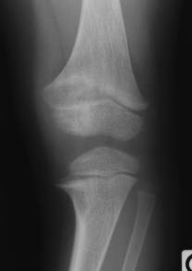
Ricketic bowing is signaled by widening and cupping of the physis at multiple sites.

Slide 47
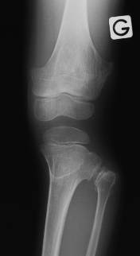
Other skeletal dysplasias are also distinguished based on their characteristic findings on radiograph.

Slide 48
The level of the proximal fibula in relation to that of the tibia.
Normally the upper border of the proximal fibular epiphysis is in line with the upper tibial growth plate – well inferior to the joint horizontal orientation line.
Blount’s disease, congenital longitudinal deficiency of the tibia, and achondroplasia demonstrate relative overgrowth of the fibula, and the fibular epiphysis is more proximal, near the joint line .

Slide 49
When To Refer ?
Pathologic deformities:
Asymmetrical.
Localized.
Progressive.
Not expected for age.
Exaggerated physiologic deformities:

Slide 50
TREATMENT

Slide 51
In the vast majority of cases, genu varum will correct with growth.
In physiologic genu varum education and assurance of the parents is important and just follow its natural course by reassessing the child in 6 months.

Slide 52
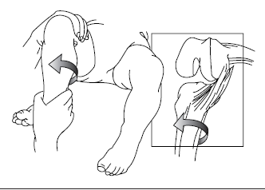
For the overly concerned parent, “treatment” to expedite this natural resolution consists of daily knee stretches .
Method for stretching the posterior oblique ligament.
The tibia is externally rotated with the knee in a 90° flexed position.

Slide 53
Orthopedic shoes are not effective in its prevention or management.
When severe genu varum is associated with severe medial tibial torsion and the metaphyseal-diaphyseal angle is 11 degrees or greater, a Denis Browne splint is prescribed with the feet rotated laterally and with an 8 to 10-inch bar between the shoes.

Slide 54
This is ordinarily worn only at night for a period not more than 3 to 6 months in order to correct excessive medial tibial torsion .

Slide 55
Tibia vara :
There are still no generally accepted criteria for initiation of treatment in infantile tibia vara.
Persistent internal tibial torsion, lateral thrust and posterolateral instability are influence a decision to initiate early treatment.

Slide 56
If the angle is greater than 16 degrees, treatment probably should be initiated.
Children with metaphyseal-diaphyseal angles between 9 and 16 degrees are generally treated if there has been no tendency toward correction after 24 months of age.

Slide 57

The brace is worn nearly full-time, especially during walking, to minimize the valgus stress at the knee.
The effectiveness of the brace is related to the relief of weight bearing stresses on the medial physeal region of the proximal tibia.

Slide 58
Brace treatment is reported to be successful in 50% to 80% of the patients treated.
The brace is worn until the deformity has been corrected which usually takes about 1 year.
Thus, bracing is usually not a viable option for children over the age of 3.

Slide 59
Metabolic deformities such as rickets could simply be corrected with medical treatment, i.e. calcium and vitamin D supplements.

Slide 60
In the adolescent with severe genu varum with marked malalignment of the mechanical axis of the lower limbs, occasionally osteotomy of the tibia or hemi epiphysiodesis of the distal femur and/or proximal tibial physis is indicated.
Restoration of the mechanical axis of the limb is the principal goal of treatment.

Slide 61
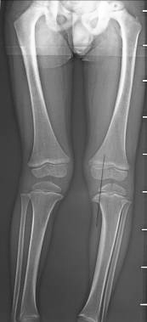
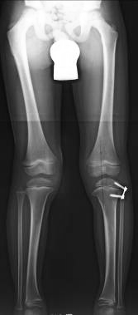
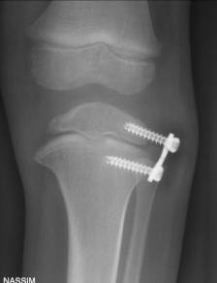
It is difficult to calculate the exact age for hemi-
epiphysiodesis.
Stapling is preferred by some authors.

Slide 62
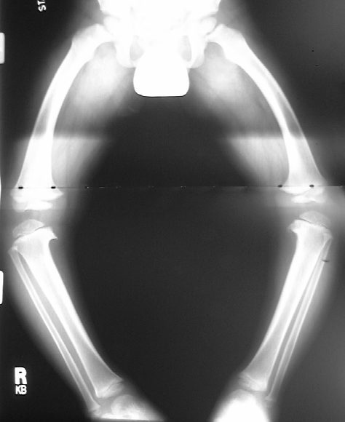
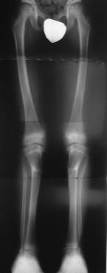
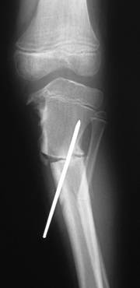
Ostéotomies

Slide 63
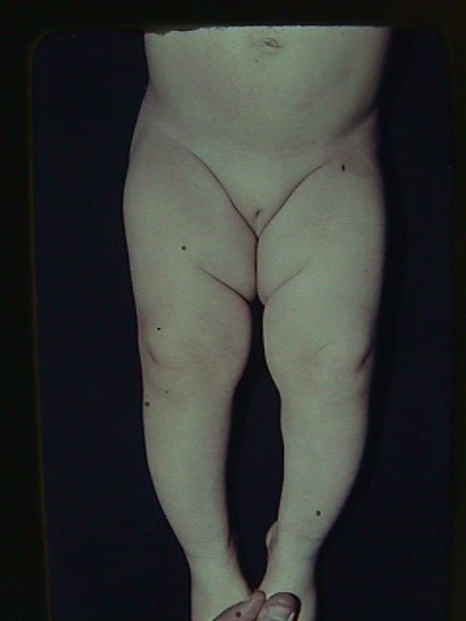
NORMAL VARUS IN INFANCY
Corrects spontaneously

Slide 64
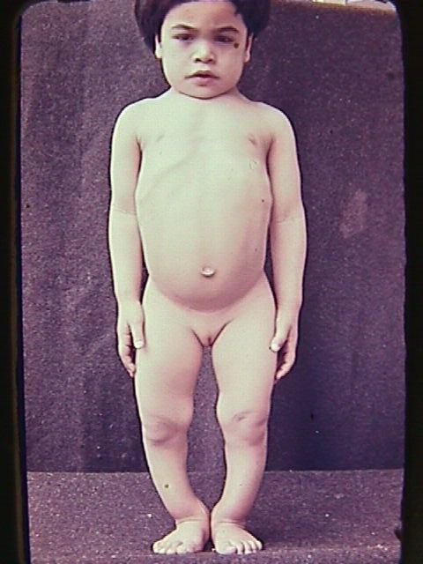
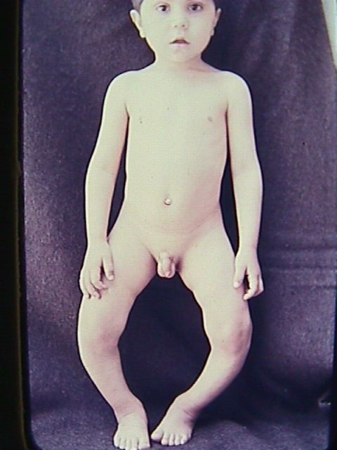
Pathological GENU VARUM
Rachitic
Blount’s disease

Slide 65
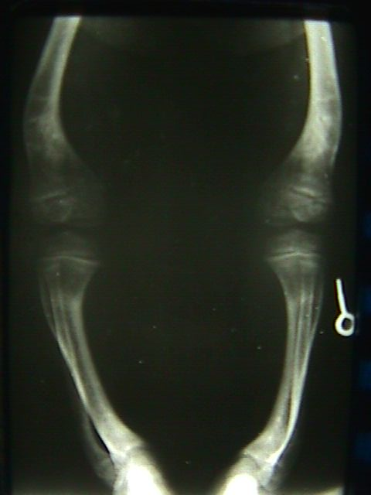
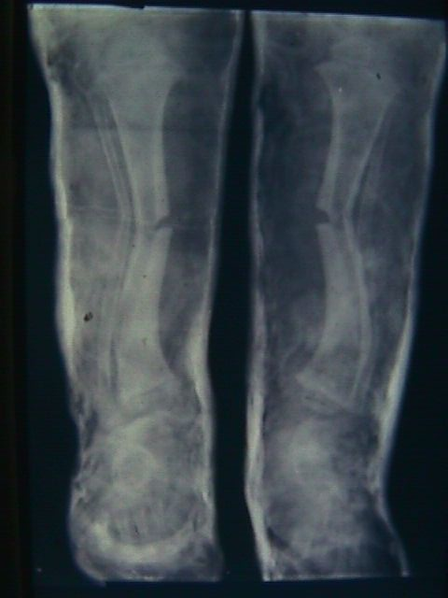
Osteoclasis at age of three correction and plaster

Slide 66
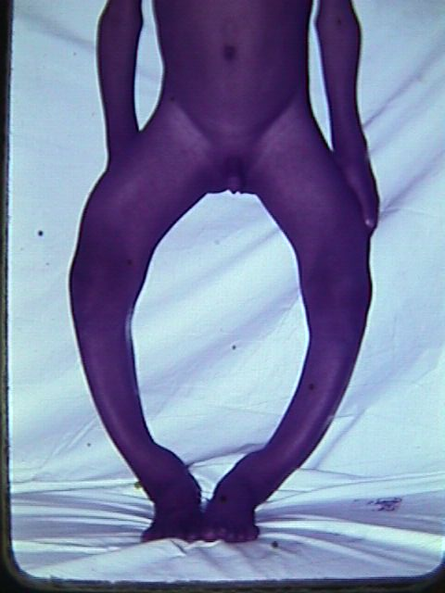
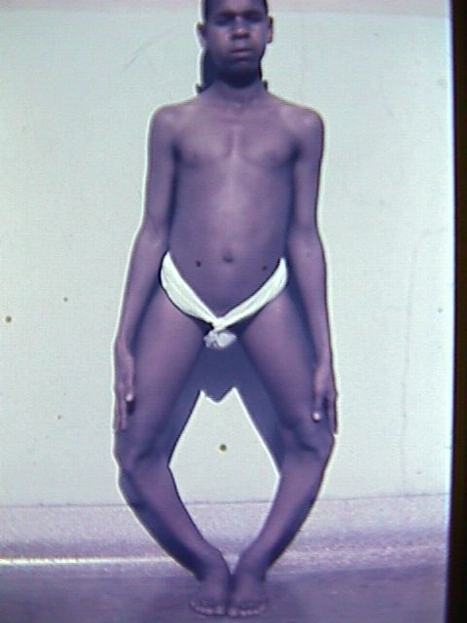
Rachitic bow legs
Tibia vara legs straight

Slide 67
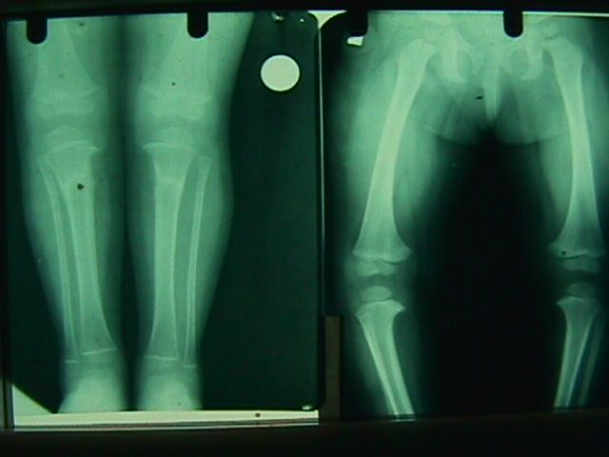
Late rickets bialateral osteotomy

Slide 68
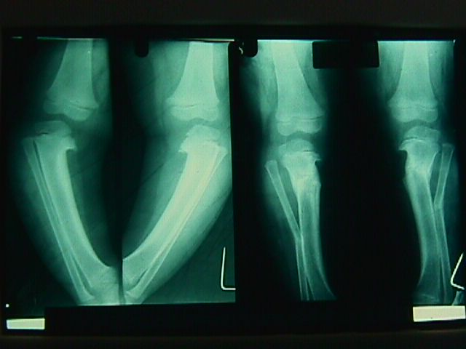
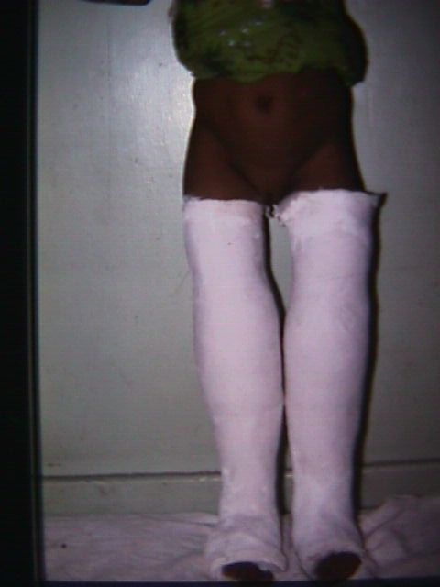
Blount disease infracondlyar osteotomy

Slide 69
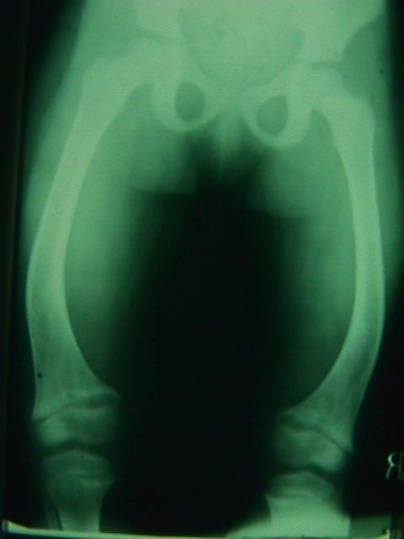
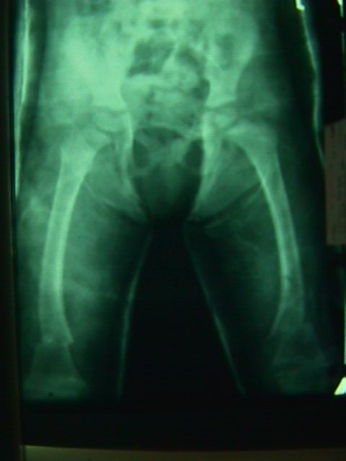
FEMORAL BOW LEGS
Bilateral supraconylar osteotomy

Slide 70

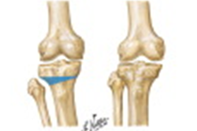
O.A. G.VARUM
Standing films are essential
High tibial ostetomy

Slide 71
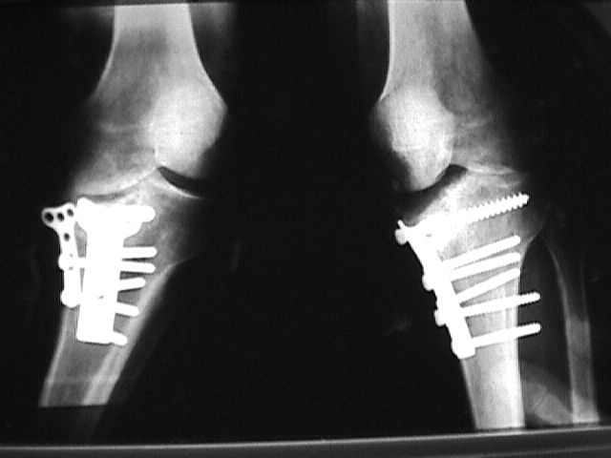
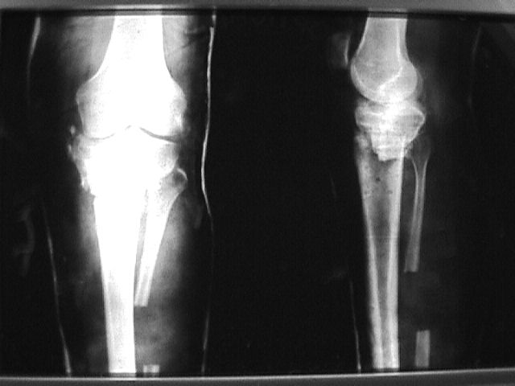
POST-TRAUMATIC GENU VARUM
Depressd medial condyle inspite of fixation
Corrective osteotomy and bone graft

Slide 72
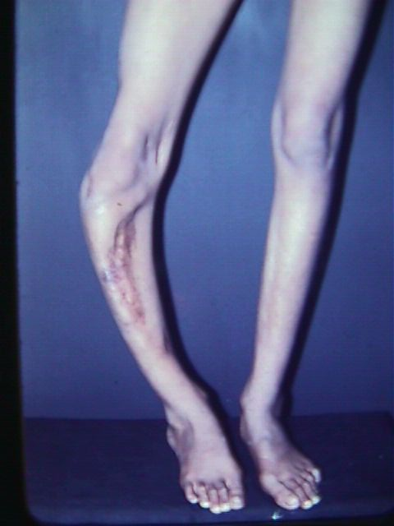
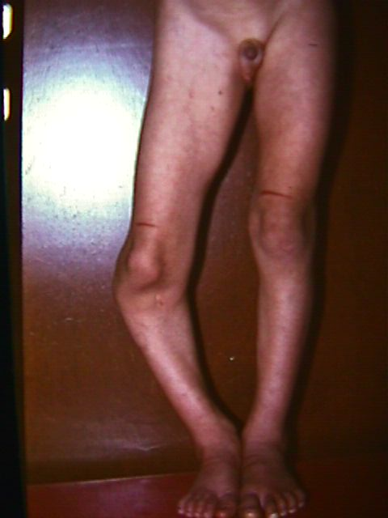
OSTEOMYELITIS GROWTH PLATE AFFECTION GENU VARUM

Slide 73
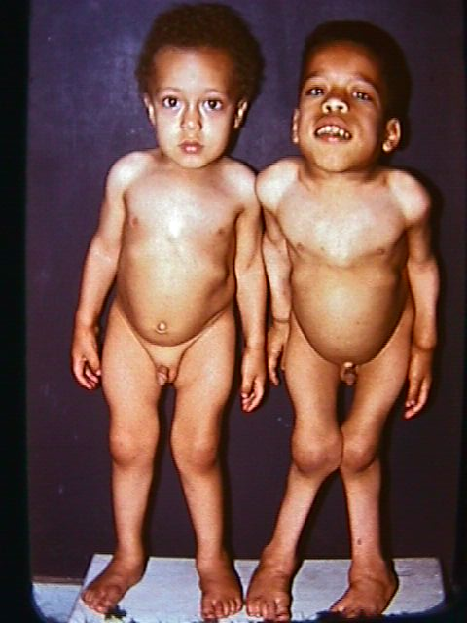
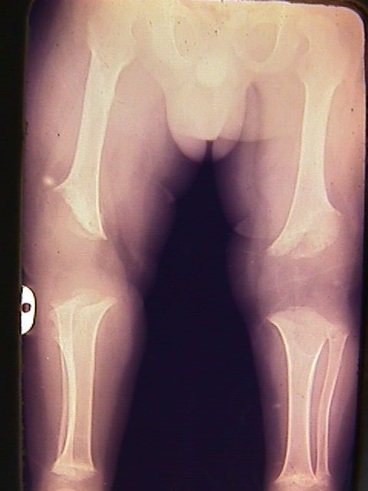
CHONDROSTEODYSTRPHY MULTIPLE EPIPHYSIO-METAPHYSEAL
4 YEARS
9 YEARS

Slide 74
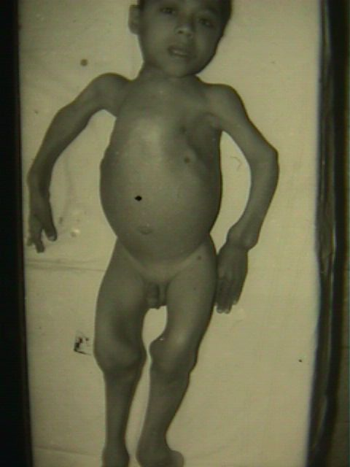

RENAL RICKETS
Age ten years

Slide 75


RENAL RICKETS
Pseudo-fractures,wide epiphyseal plate

Slide 76


OSTEOGENESIS IMPERFECTA
Sofield multiple level osteotomies

Slide 77
Principles of Evaluation and Treatment;
Genu varum is physiologic until the age of 18 to 24 months, and treatment is unnecessary.

Slide 78
(2) In a child with normal stature and findings compatible with physiologic bowing, radiographic documentation is unnecessary.
Photographs are less expensive and just as valuable.

Slide 79
(3) If radiographs are deemed necessary, full-length standing films of the entire lower limbs are required for the evaluation of the mechanical axis and the site of deformity.
(4) Shortness of stature should signal the likelihood that a constitutional disorder is the cause of genu varum.

Slide 80
(5) Idiopathic tibia vara is the most common pathologic cause of bowlegs in the child.
Bracing may be effective in the early stages, but this has not been established by prospective controlled clinical trials.

Slide 81
(6) Surgical correction of tibia vara can be guided by the principle that reestablishing a normal mechanical axis in the early stages will allow normal growth to occur.

Slide 82
(7) There are various types of internal and external fixation, all of which are satisfactory.
(8) Treatment of genu varum secondary to constitutional disorders must be tailored on an individual basis.

